Slide 1

Data Science Project: Predicting All Time Rank
MD Islam, Adrian Flores, Keyvan M. Kani

Slide 2
Table of contents
01
02
03
Project Overview
Data Analysis
Algorithms
04
05
06
Final Results
Reflection
Responsibilities
Project description, details, and goals
Details about the data
Algorithms that address project requirements
The developed codes and final results
Comparisons of algorithms (accuracies, AUC, & ROC curves)
The responsibility of each team member

Slide 3
01
Project Overview
Project description, details, and goals

Slide 4
About the project
This project explores music streaming trends using the "Most Streamed Spotify Songs 2024" dataset. It identifies factors behind high streaming counts, popular genres, and correlations between song attributes and popularity. Predictive models like Decision Tree, KNN, and Linear Regression classifiers are used to predict the "All Time Rank." Our goal is to offer actionable insights for artists and producers to enhance performance across streaming platforms.

Slide 5
02
Data Analysis
Details about the data

Slide 6
Data Analysis
Dataset Description
Data Format
Key Insights
The dataset contains comprehensive information about the most streamed songs in 2024. Each row represents a unique song, capturing its attributes and streaming metrics. The dataset is suitable for supervised and unsupervised learning tasks
Rows: Each row corresponds to a unique song
Columns: Attributes like genre, artist, streams, etc.
Data Types:
Contains numeric data (total streams) and categorical data (Album Name)
Features: All features that contain numerical data (Track Score, Spotify Streams, etc.) will be used for training and testing data label
Label: The “All Time Rank” will be used for the algorithms for predictions

Slide 7
03
Algorithms & Tools
Algorithms & tools that address project requirements

Slide 8
The Algorithms
Decision Tree Classifier
Logistic Regression
K-Nearest Neighbors
A supervised learning algorithm used for classification. This algorithm was a good first choice as this classifier works well for both categorical and numerical data, which closely aligned with the dataset. This classifier outputted an accuracy of 99%.
A linear model for classification tasks. Also commonly used to predict probabilities by using the sigmoid function. This algorithm was highly effective resulting in an accuracy of 96%.
A basic but yet essential classification algorithm. Like Decision Tree, it can handle both numerical and categorical data. However, the algorithm didn’t yield the highest accuracy resulting in a score of around 69%.

Slide 9
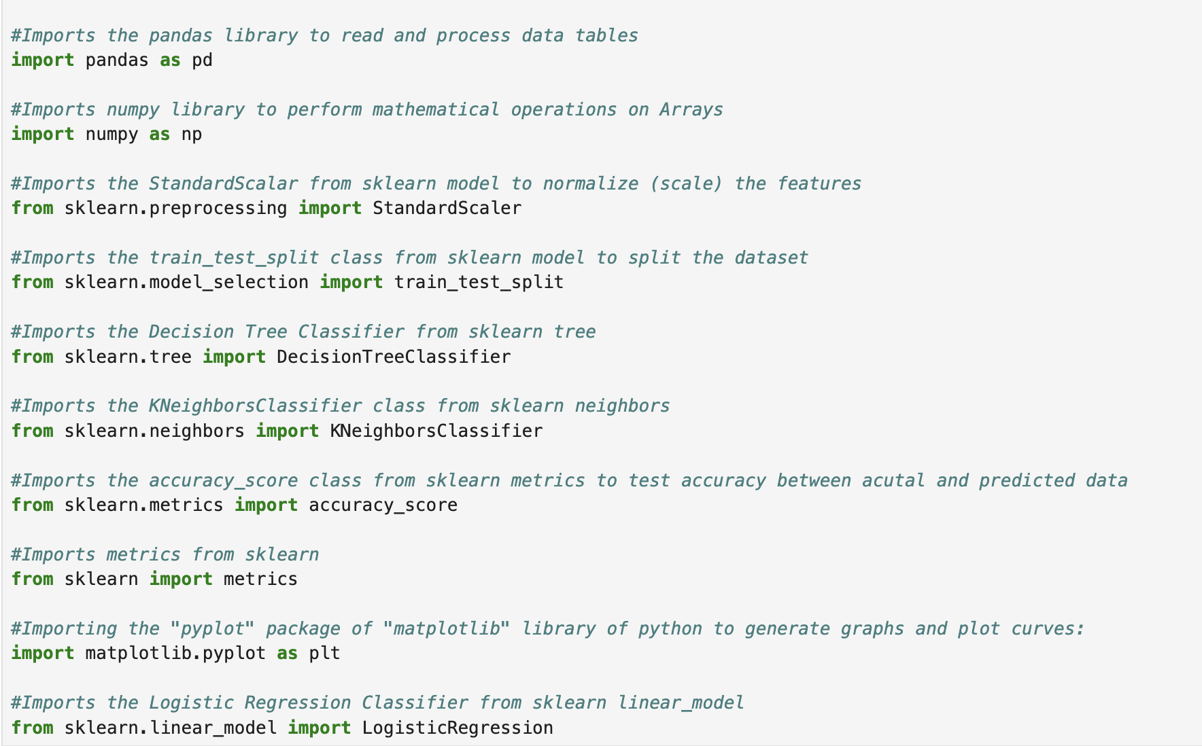
The Tools

Slide 10
04
Final Results
The developed codes and final results

Slide 11
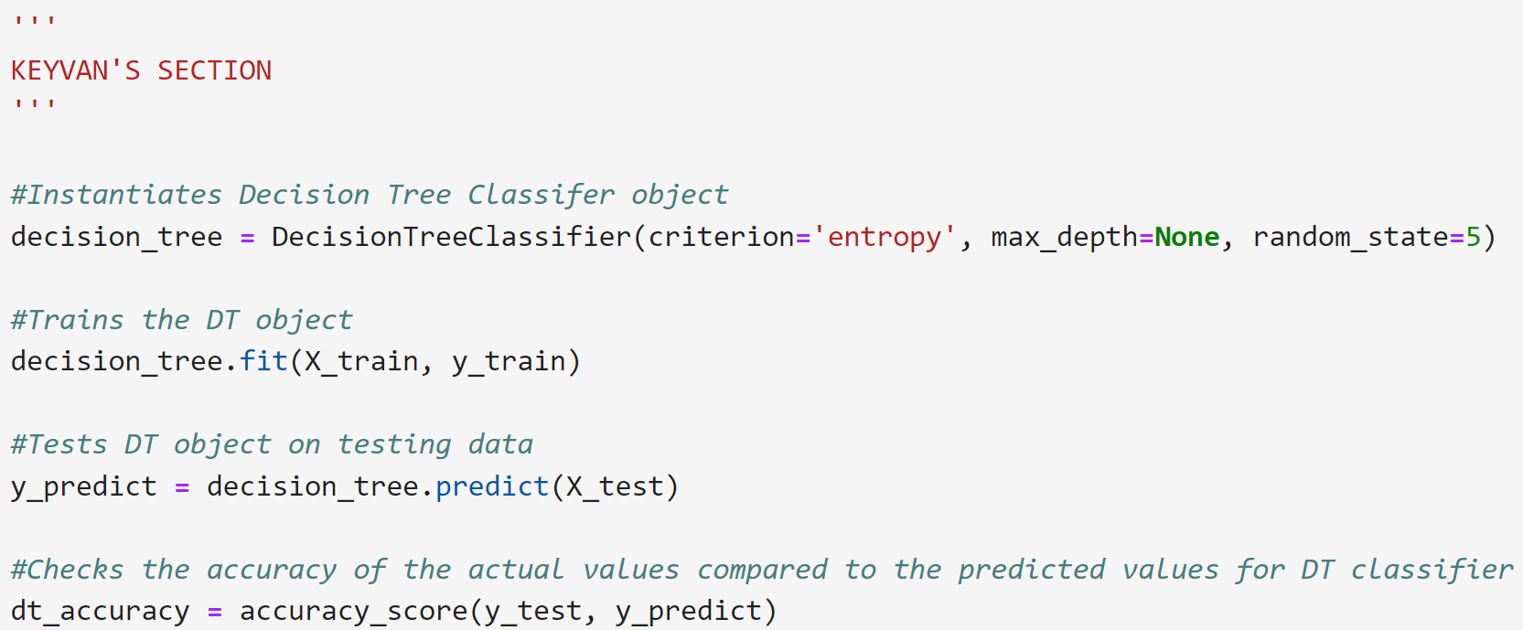
Decision Tree Classifier (Code Part 1)

Slide 12
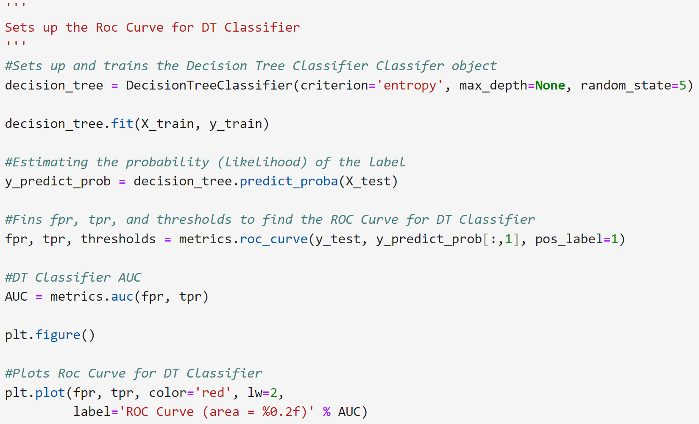
Decision Tree Classifier (Code Part 2)

Slide 13
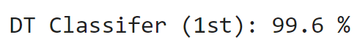
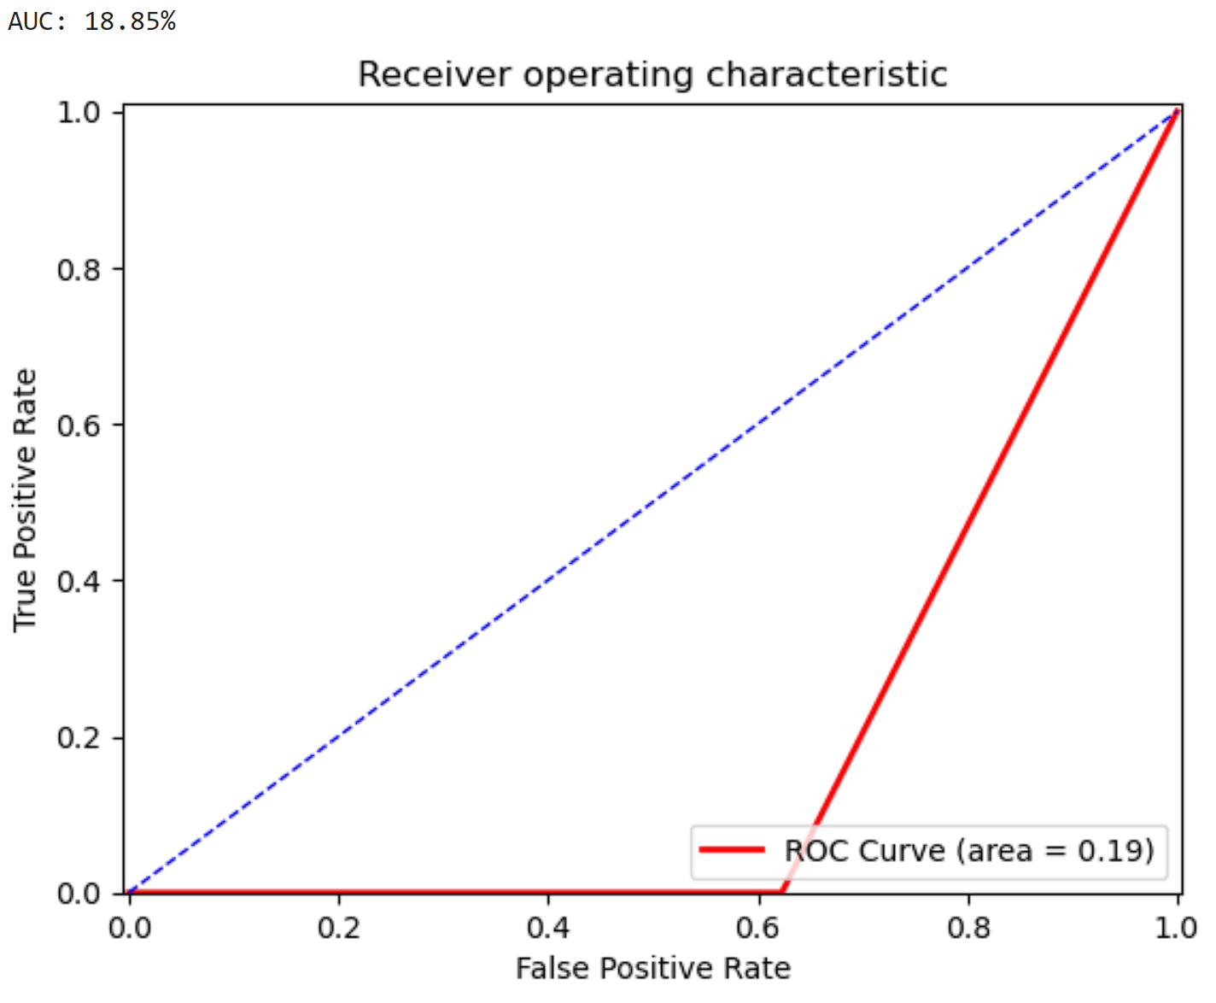
Decision Tree Classifier (Results)

Slide 14
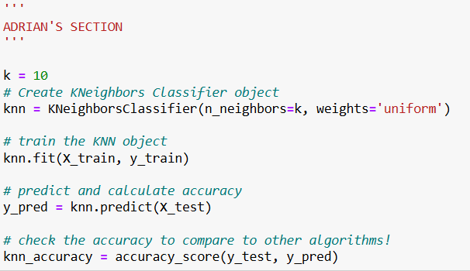
KNeighborsClassifier (Part 1)

Slide 15
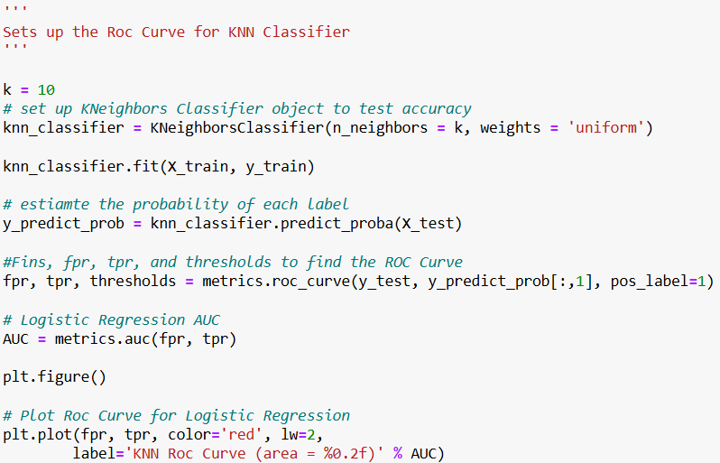
KNeighborsClassifier (Part 2)

Slide 16
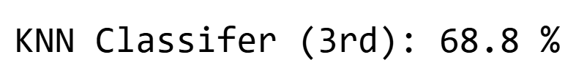
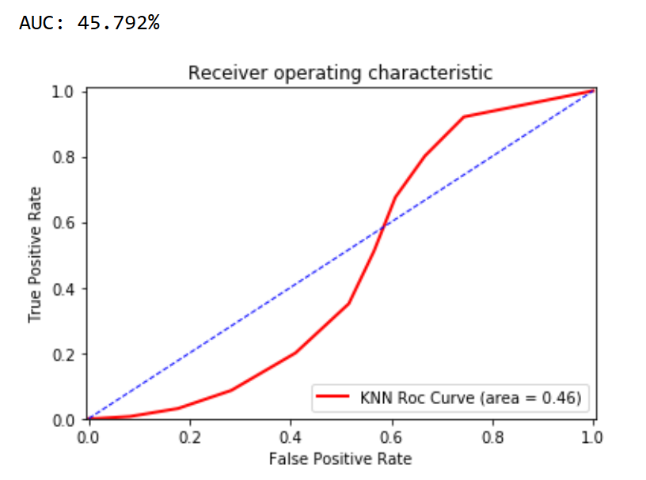
KNeighborsClassifier (Results)

Slide 17
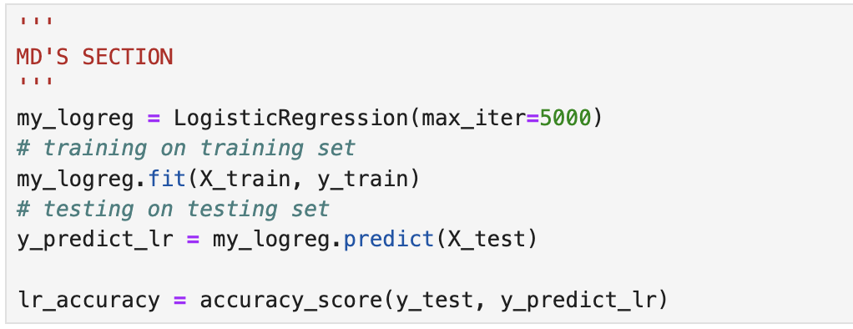
Logistic Regression (Code Part 1)

Slide 18
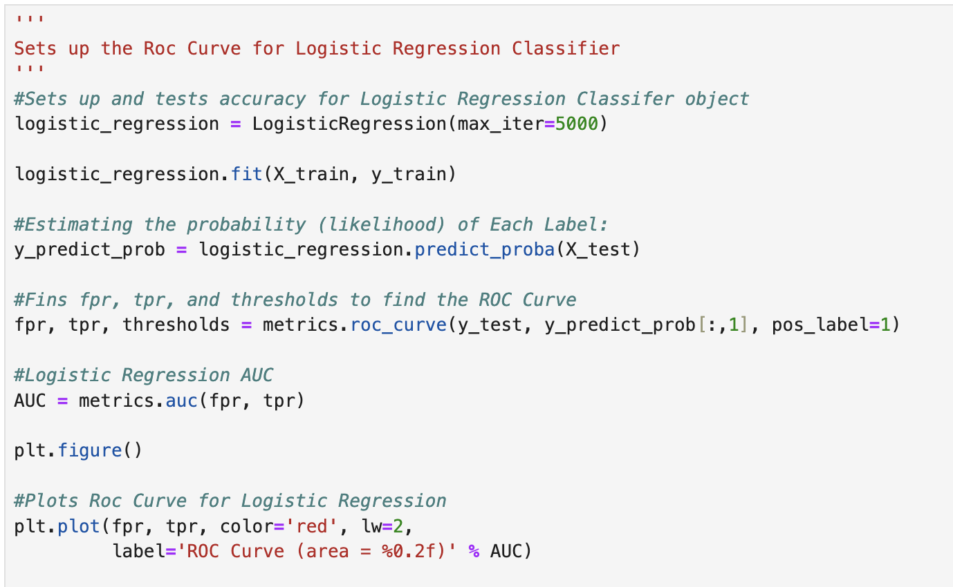
Logistic Regression (Code Part 2)

Slide 19
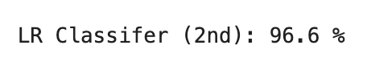
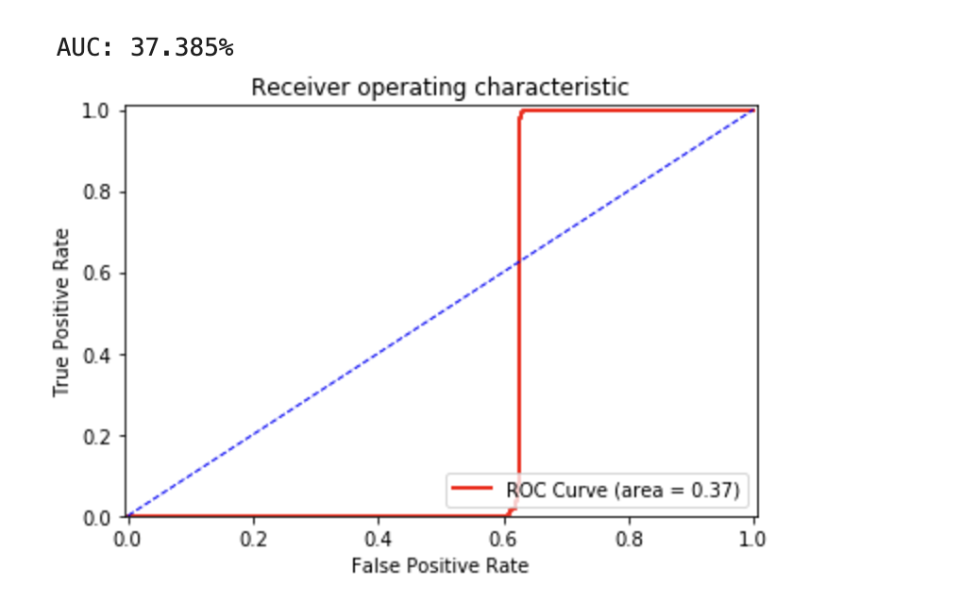
Logistic Regression (Results)

Slide 20
05
Reflection
Comparisons of algorithms (accuracies and ROC curves)

Slide 21
Comparison
In terms of accuracies, the Decision Tree Classifier had the highest accuracy of 99.6%, but the KNN Classifier had the highest AUC of 45.8% and ROC Area of 0.46!

Slide 22
06
Responsibilities
The responsibility of each team member

Slide 23
Task Breakdown
Keyvan M. Kani:
Decision Tree Classifier
Presentation Report + Slides
Md Islam:
Logistic Regression
Presentation Report + Slides
Adrian Flores:
KNN Algorithm
Presentation Report + Slides

Slide 24









Thank you for attending our presentation!

